Slide 1
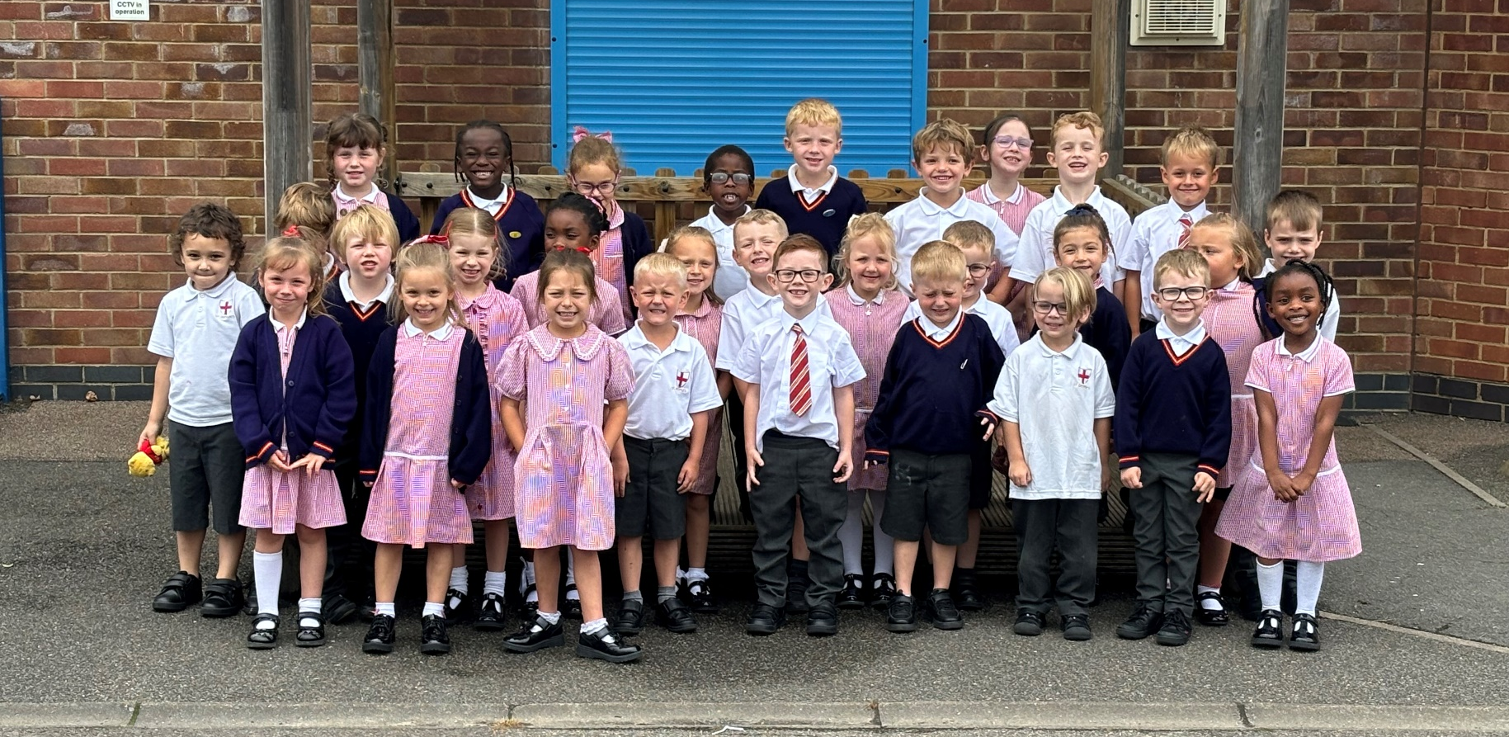
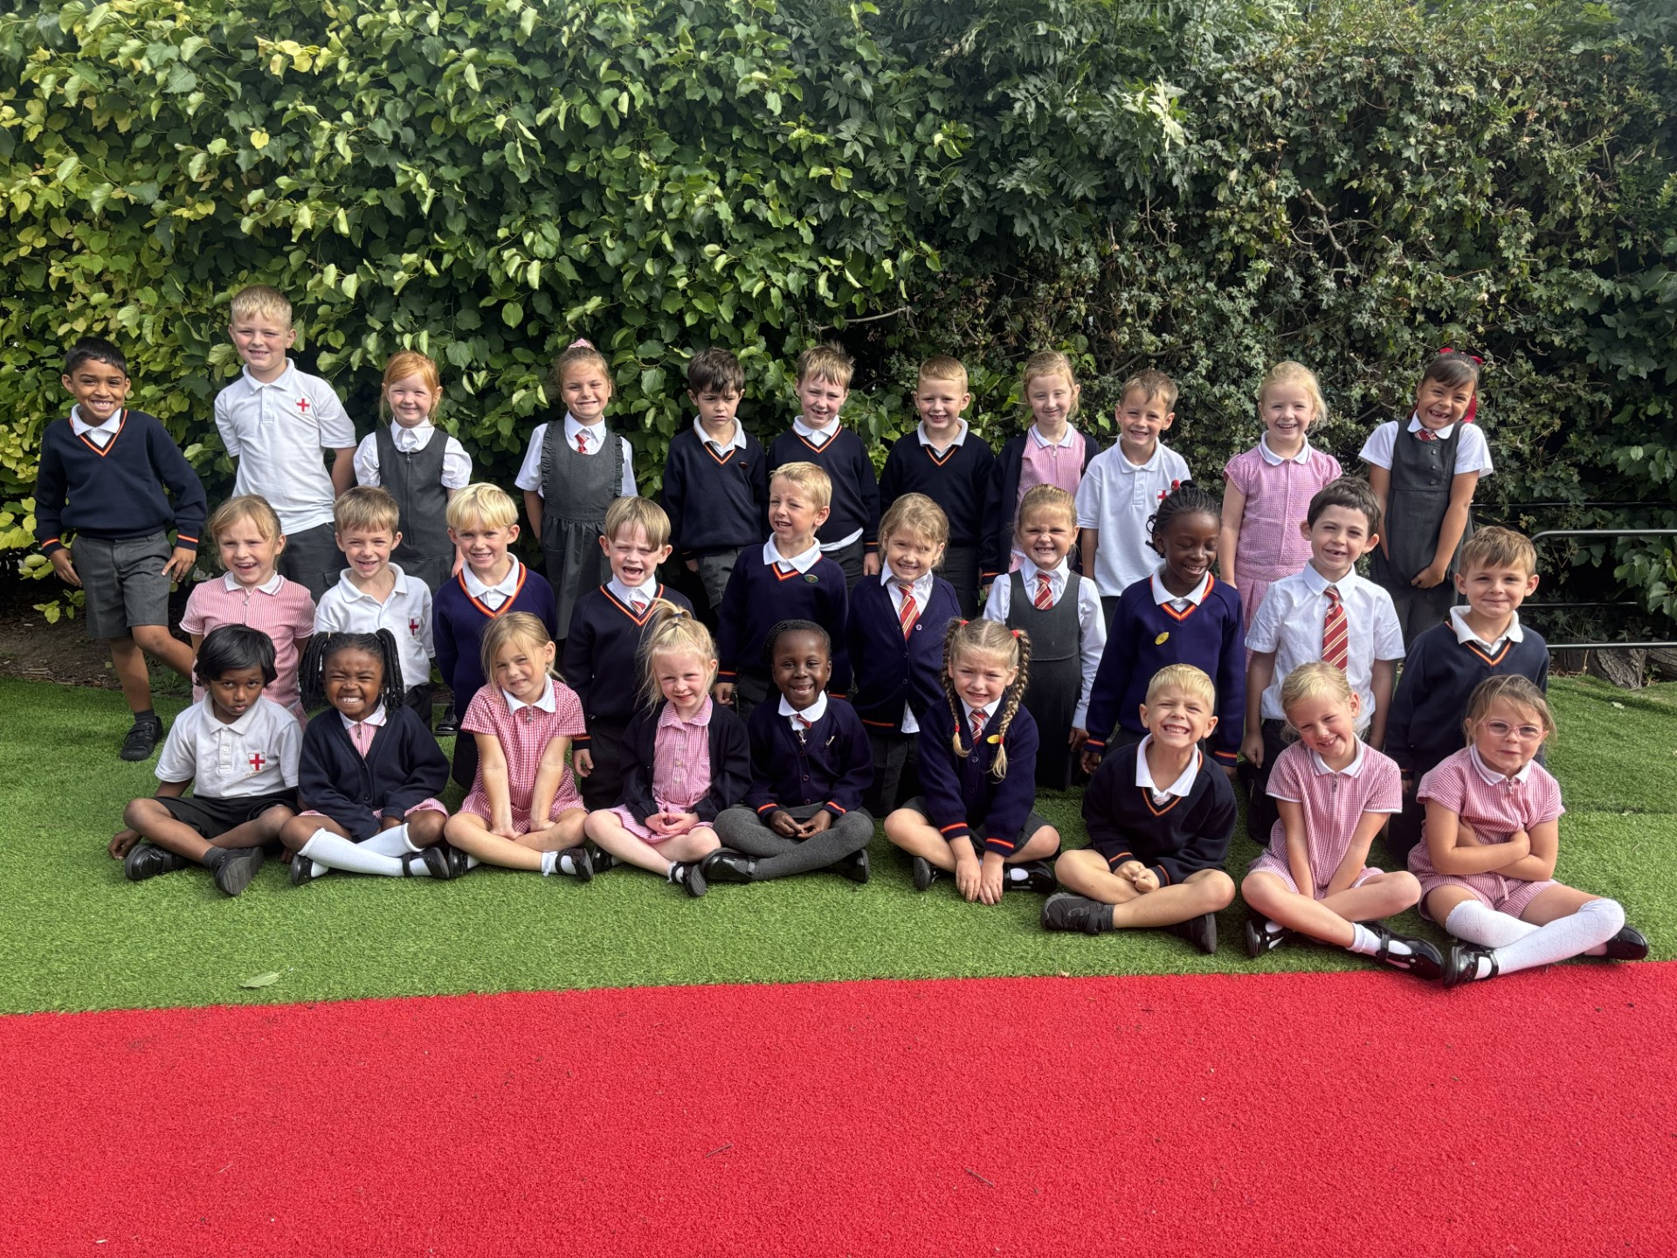
Parent Information
Year 1

Slide 2
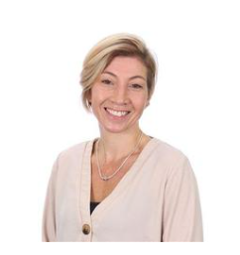
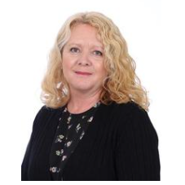
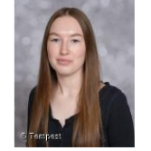
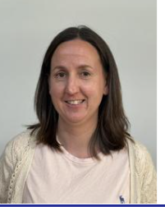
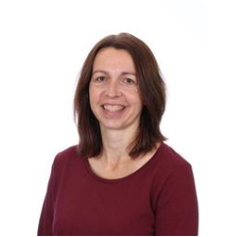
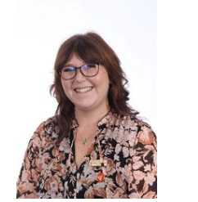
Staff in Year One
Class Teacher - Mrs Stannard
Teaching Assistant–
Mrs Sapsford
Miss Coyne
Mrs Stoner
PPA cover - Mrs Arnold
Science – Mrs Bracknell

Slide 3

A positive relationship between home and school is crucial.
Throughout the year there will be parent meetings.
All children are individuals and encouraged to be the best they can be.
Children are rewarded through: House points, Head teacher awards, Celebration assemblies, Artist of the month, Reading awards and Sports awards.

Slide 4
Rewards!
Star of the Day – A star of the day is chosen every day for various reasons. We award a sticker as well as having their photo up on the board. Stars of the day get to sit on the special chair, have special jobs to do and are always first in the line!
Pom poms in buckets - Poms poms are awarded in year 1. This can be for excellent work, trying hard, persevering, being kind etc. The list goes on! When the bucket is full the children get to choose a special voucher which will go home with them.
For every pom pom there is a house point awarded.
We have a ‘Wow Work’ board where special work is on display.

Slide 5
READING
Every child will read in a group practise reading session 3 times a week. In year 1 our books will go home on a Wednesday and we ask that they are returned the following Wednesday. A sharing book will also be chosen by the children to read at home.
Please make sure you write in the reading record so that we can count the reads. It is really helpful to have a comment about your child’s reading. School staff use a red pen so it would be really helpful if you could use an alternative colour.
Reads will be counted from the 8th September.

Slide 6
Phonics
We are continuing with our Little Wandle reading and phonics scheme. Reading groups take place on a Monday, Tuesday and Wednesday in Year One. Books will go home every Wednesday. It is helpful to have books in children’s bags every day as we will try to fit in extra reading whenever we have an opportunity!
Phonics is taught daily, currently in two different groups. Phonics assessments take place half termly.
Phonics Screening will be in June next year. More information for parents will be available a little closer to the time.

Slide 7
Behaviour
High expectations for all children in terms of behaviour ensures all children will feel safe and happy.
Children are aware of our RESPECT ethos and this is for all children and adults in our school.
Being a role model inside and outside of school helps the children to be the best they can be.

Slide 8
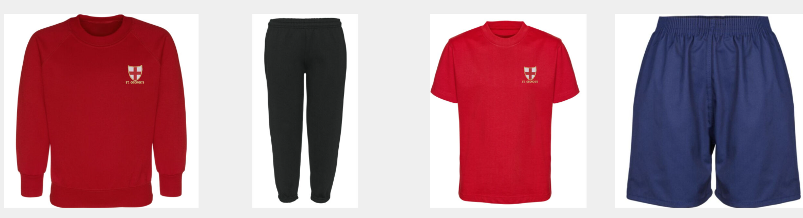
P.E.
Our P.E. day is a Thursday. Please come into school every Thursday in P.E. kit. Our ‘Mighty Mile’ will take place on a Thursday and Friday so we will need trainers and school shoes on a Friday.
Please label all of your children’s P.E kit in either a permanent pen or a sewn in label.
Bug spray!

Slide 9
Cultural Capital
As well as our usual topics and curriculum we aim to provide the children with extra experiences to enhance their life experiences and add some fun, joy and wonder to their lives. This may include spending time at the beach, the playground, cooking, planting, playing, to name a few.

Slide 10
Homework
Reading is our main homework in year 1.
10 minutes every day is hugely beneficial and we would really encourage families to fit that in. Please write in the reading record when reading has taken place.
In addition we will be sending home a phonics and tricky words sheet that have been taught that week. Please do practise with the children.
Website – www.sgcps.co.uk

Slide 11
Photos
We do use photos as evidence in our books and do like to upload photos (without names) onto the website and social media to share the exciting events in year one.
If you are happy for this to happen, do please update any permission slips.

Slide 12
Please help us!
Do share any concerns with us.
Please label clothes, water bottles, lunch boxes, everything!
Have spare clothes in their bags.
Please encourage your children to be independent and responsible for themselves and their things.
Water bottles must be in school every day and labelled. Only water in the classroom please.
Fruit or vegetables are provided for snack but children may bring their own piece of fruit or vegetable if they wish.
Lunch boxes must not contain nuts.
Home time – 3.10pm for Year 1.

Slide 13
Ensure personal contact details are up to date in the office.
Changes to end of day collection arrangements – Either let an adult know in the morning or email/phone the school office.
Ensure children have a sun hat in their bag and a coat as our weather is so unpredictable!
The children will become very tired as the term progresses, please send them to bed early!

Slide 14
Punctuality – Working for punctuality points – Being late impacts on learning. There are class punctuality rewards!
Attendance – We want to see you – However, remember it’s 48 hours off for sickness and diarrhoea.
Communicating – Please communicate through the office where all information is passed on, I will get back to you as soon as I can.
School Uniform – Uniform changes are indicated on news letters and on the school website. Please label everything!
Please ensure children have coats in school.

Slide 15
Topics
We are currently looking at ‘All about me’.
Our R.E. topic is currently all about Creation.

Slide 16

Year 1
We are going to have a fun filled year with opportunities for all to shine.
Supporting your child and the year 1 team will ensure we can all be the best we can be.
Thank you for coming and listening, any questions please feel free to email the office and I will get back to you as soon as I can.

Slide 17
Thank you for coming to our parent meeting.

