Slide 1
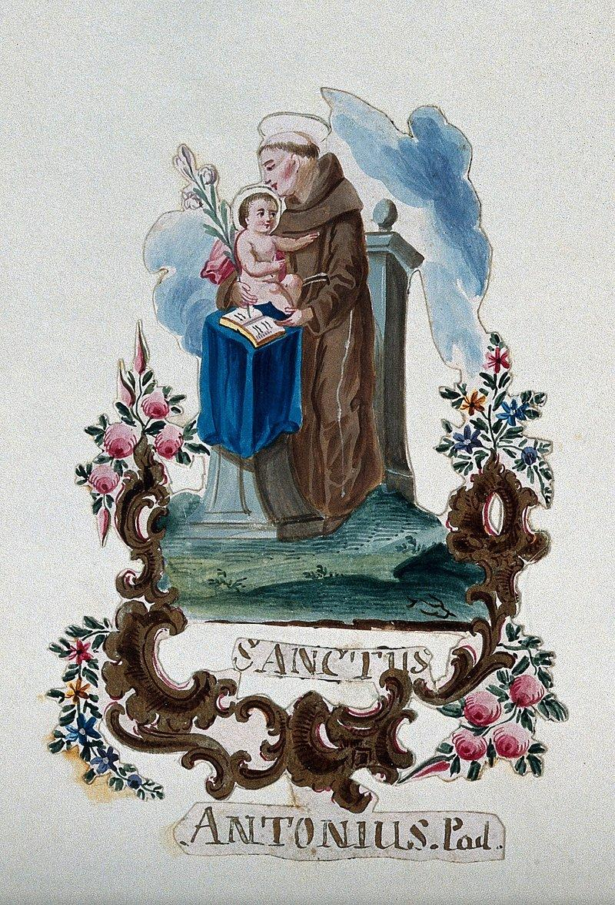

Welcome to the Year 5, St Anthony’s Parent and child Information Session.

Slide 2

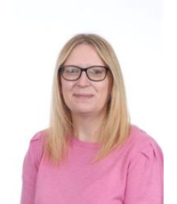
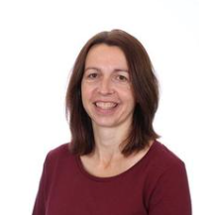
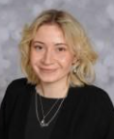
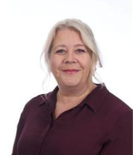
Year 5 Staff Team
Mrs Marquis – Class teacher
Mrs Arnold – PPA cover (Tuesday morning 9:30-12:00)
LSAs – Miss McLoughlin - AM
Mrs Thorne - PM

Slide 3

A positive relationship between home and school is crucial.
Throughout the year there will be parent meetings in October and March.
All children are individuals and encouraged to be the best they can be.
Children are rewarded through: House points, Head teacher awards, Secret Student, Celebration assemblies, Artist of the month, Reading awards and Sports awards.

Slide 4

Key Points
Punctuality – Working for punctuality points – Being late impacts on learning.
Attendance – We want to see you – However, remember it’s 48 hours off for sickness and diarrhoea.
Communicating – Please communicate through the office where all information is passed on, I will get back to you as soon as I can.
School Uniform – Uniform changes are indicated on newsletters and on the school website. Please label all uniform.

Slide 5

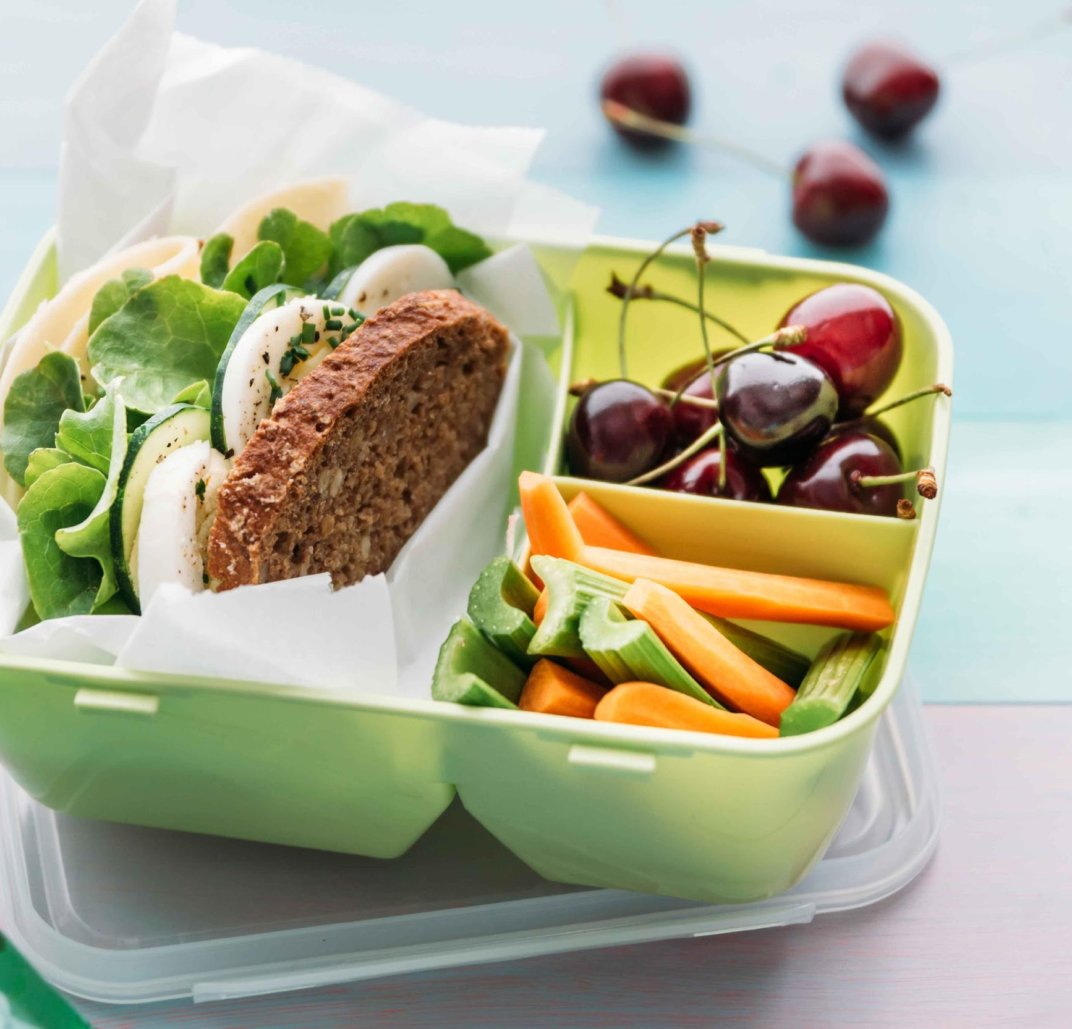
Key Points
Practice makes perfect – Completing homework and practising what we are learning in class will help cement knowledge gained. Please encourage your children to complete homework.
Water bottles – please have a named bottle in school each day.Sun hat or coat.
Healthy school policy - we encourage healthy options for break and lunch
No pencil cases until Spring term.

Slide 6
Behaviour
High expectations for all children in terms of behaviour ensures all children will feel safe and happy.
Children will be engaging in a new workshop with Mrs Delgado and the class team.Our RESPECT ethos is for all children and adults in our school. Included in your pack is a code of conduct for parents.
Being a role model inside and outside of school helps the children to be the best they can be.

Slide 7

P.E
Our P.E day will be Tuesday (P.E Kit).
Daily Mile on a Tuesday and Thursday (trainers in bag).
Please have the correct P.E uniform. Labelling uniform will help to get it to the right owner. Ensure all children have a labelled water bottle.
We will be covering a range of topics in P.E including: gymnastics, netball, tag rugby, dance, athletics and cricket.

Slide 8

Reading
Reading at home with a sibling or adult will help improve fluency and understanding.
Reading school books, reading home books, all reading is important.
Please write in your child’s red reading record, what they enjoyed, what they found tricky. Any words that they did not comprehend. Also the page they have read to so we can continue or finished so we can change the book.
Children will be able to change their books as and when they have read them. They must be in school every day and after reading they will discuss the book to check inference. It is not just being able to read, it is ensuring you understand what they have read.
Reading recorded from the 8th September will be recognised towards reading milestones.
Notes:
We will hear some regular readers but also be doing WCR where we will be hearing reading. Reading awards will be starting from 12th September

Slide 9


Reading Picnic
Each Friday, a child will bring home the reading picnic basket, inside there will be;
A mysterious book to start
A treat
A book mark
A scrapbook where you can add a picture or a comment
A cosy blanket
You read as much of the book as you can, on your own or with a loved one. When you return it the following Friday you will share an oral review of the book with the class.
Notes:
We will hear some regular readers but also be doing WCR where we will be hearing reading. Reading awards will be starting from 12th September

Slide 10

RHSE - Relationship, Health, and Sex Education
We use the ten:ten resources which adhere to the Catholic ethos and interlinking Catholic Social Teaching, these are taught throughout the year. They ensure that the children have a good understanding and it is built upon year after year.
Notes:
https://www.tentenresources.co.uk/

Slide 11

Homework - (or as Addilyn said, “extended learning”).
Most importantly is reading daily, it will help across all subjects.
Practise spellings – on class page on website for the term, there will be dictation of spellings on a Friday.
Big Write - a chance to discuss and develop oracy prior to writing a story, article, poem independently. SPAG work relating to what we have been learning in class.
Maths - related to what we have been learning in class that week.
Homework is given out on Friday and returned the following Friday, where we will go through it in class.

Slide 12


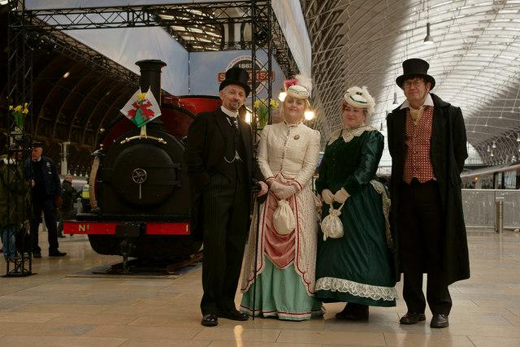
Cultural Capital
We will cover an array of topics including Brazil, Maps, Rivers, Victorians and Ancient Greeks often linking to local knowledge.
Year 5 will have a range of opportunities to participate in different experiences both in school and off site.
Trip to Pizza Express this month,Braintree in April, Stargazing evening.
Notes:
Children will also be learning to play the keyboard and will have the option to access individual music lessons.

Slide 13
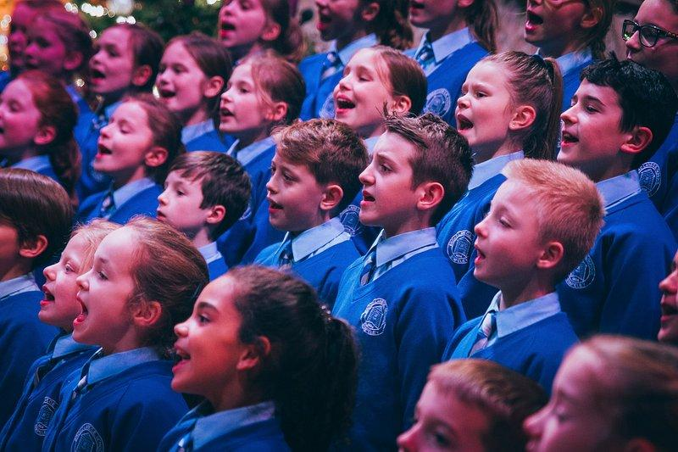
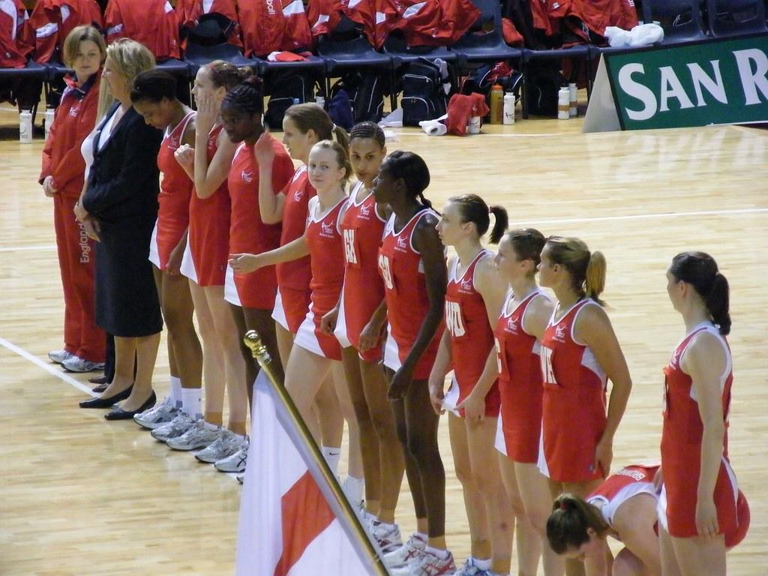
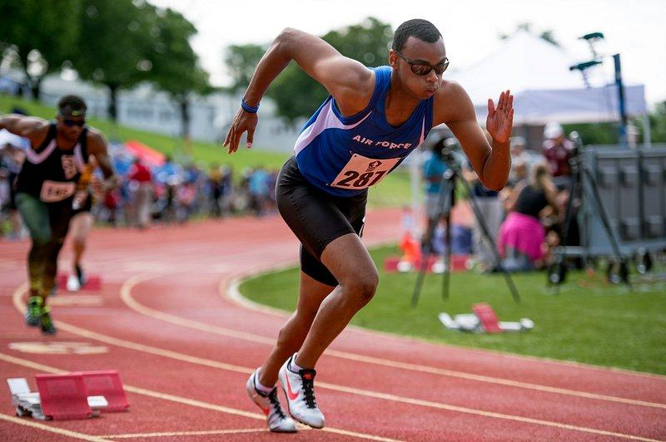
CLUBS
Please encourage your child to sign up to some of the wide range of clubs that the school offers.
Participating in clubs encourages friendships, a positive mindset and achievement.

Slide 14


Punctuality is important, if children are late they miss early morning work or interventions.
If attending a sporting club, children will need to bring in P.E kit to change into. They will wear school uniform throughout the day.
P.E is on Tuesday, children should have P.E kit appropriate for the weather. Trainers need to be brought in for Daily Mile on Thursday.
Please inform the office of any arrangements for who is collecting your child on what day.
Any queries please contact the office.

Slide 15

We are really looking forward to this academic year.
Supporting your child and the year 5 team will ensure we can all be the best we can be.
Thank you for coming and listening, any questions please feel free to email the office and I will get back to you as soon as I can.

